Slide 1
tuesday 24/11
Today, we’ll review 522’s Project Briefing with notetaking and explore Topic Selection by reading and listening!
Be ready to take notes in spiral!
Agenda

Slide 2

How did you like this training sessions?
ⓘ Start presenting to display the poll results on this slide.
Notes:
📣 This is Slido interaction slide, please don't delete it. ✅ Click on 'Present with Slido' and the poll will launch automatically when you get to this slide.

Slide 3
documentation resources https://github.com/minajs9918/522-SEMEVAL4-Grp/tree/master/522_GrpSEMEVAL_site

Slide 4
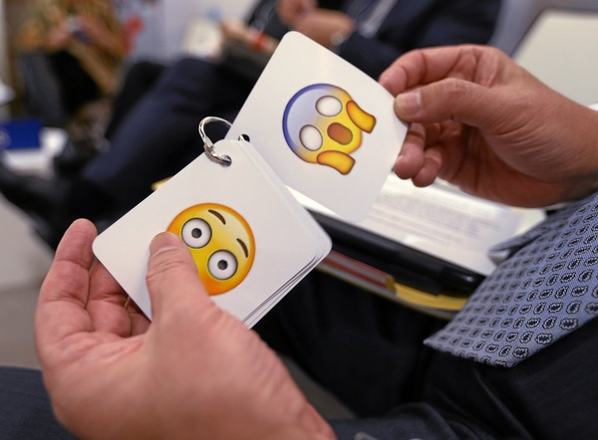

Topic selection
A WORD EMBEDDING APPROACH AND SENTIMENT ANALYSIS ON TWITTER DATA FOR CUSTOMER SERVICE SECTOR

Slide 5
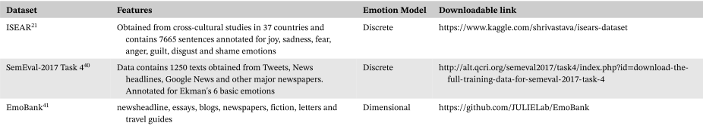
Dataset
Semeval-2017 task 4 https://alt.qcri.org/semeval2017/task4/index.php?id=download-the-full-training-data-for-semeval-2017-task-4

Slide 6
Deliverables
MANUSCRIPT
TOPIC SECTION 1.4 – 3.1. (LING CHIAN) PHYSICAL SUBMSSION DUE ON DECEMBER 13.
POSTER
TOPIC SECTION 1.4 – 3.1. (LING CHIAN) PHYSICAL SUBMSSION DUE ON DECEMBER 13.
1
3
2
SOURCE CODES
TOPIC SECTION 1.4 – 3.1. (LING CHIAN) PHYSICAL SUBMSSION DUE ON DECEMBER 13.
4
POSTER & REPORT COMPILATION
AMENDMENT/FINAL POSTER,18 DEC
AMENDMENT/FINAL REPORT, 20 DEC
AMENDMENT/FINAL SOURCE CODE, 18 DEC SUBMIT DUE: TBA

Slide 7
Audience Q&A Session
ⓘ Start presenting to display the audience questions on this slide.
Notes:
📣 This is Slido interaction slide, please don't delete it. ✅ Click on 'Present with Slido' and the questions from your audience will appear when you get to this slide.

